Slide 1
Making this resource work for you
Prior to teaching this lesson, please refer to the ‘Unit Overview and Planning Document’.
Further guidance on planning Science Mastery lessons can be found in the detailed planning guidance document.
Refer to the ‘notes’ section on each slide for useful information, including suggested expositions, pedagogical content knowledge, suggested questions, answers and more. Consider using presenter mode so you can see this guidance throughout the lesson.
The introduction slides can be adapted to suit your teaching style and the needs of your class.
Before the lesson, adapt the fix-it slide to address any misconceptions identified in the previous lesson’s exit ticket.
Choose from the suggested activities to suit your class. The intention is not that you complete all of these, but that you select those which ones are most appropriate for your students. It may be appropriate to further adapt activities for your students.
These lessons are designed to occupy approximately 1 hour. To adapt for a shorter or longer lesson duration we advise you to adapt the activity section accordingly.
Please consider using the final slide to send feedback about this lesson or examples of PowerPoints that you have adapted to our design team. Your feedback is used to improve Science Mastery for all of our teachers and students. We appreciate all suggestions and comments.
Thank you for reading!
The Science Mastery Team

Slide 2
Taking it Further: Pressure
Answer the questions below.
Describe the relationship between pressure and temperature of a gas.
Explain what is meant by pressure.
Explain why gas pressure increases with temperature.
Which state(s) of matter can be compressed?
Suggest why it hurts more when a person stands on your foot with a high heel than a flip flop.
As temperature increases, pressure increases
The force exerted per unit area.
Particles gain energy so collide with the walls of the container more frequently and with more force.
Only gases
They exert the same force over a smaller area, so there is more pressure.
Notes:
Big idea: Energy is conserved
Foundation: Identify which state(s) of matter have a fixed shape.
Stretch: Explain why the other state(s) of matter do not have a fixed shape.
Answers:
Foundation: Solids
Stretch: The particles in a gas can move freely and the particles in a liquid can move past each other so in both cases they can flow and take the shape of a container.

Slide 3
Taking it Further: Pressure
Do Now:
Describe the relationship between pressure and temperature of a gas.
Explain what is meant by pressure.
Explain why gas pressure increases with temperature.
Which state(s) of matter can be compressed?
Suggest why it hurts more when a person stands on your foot with a high heel than a flip flop.
Drill:
State the SI unit for force.
State the equation used to calculate area of a circle.
Calculate the area of this circle.
3 cm
Notes:
Drill answers
Newton (N)
$A=πr^{2}$
r = 1.5 cm, so A = 7.07 cm²

Slide 4
Taking it Further: Pressure
Read Now:
When you apply the brakes in a car, you apply a force to the pedal to make the car come to rest. How does that small force that you apply with your foot manage to make a whole car stop? The answer is hydraulics. Hydraulics means anything to do with liquids under pressure, and the brakes in a car use a hydraulic braking system. Liquids are incompressible, because there is no space between the particles. This means that when a force is applied to a liquid, the pressure is transmitted through the liquid because the force cannot be used to compress the liquid. This means the liquid can exert the same pressure on the other side.
Describe the arrangement of particles in a liquid.
Explain the term ‘hydraulics’.
Explain why liquids are described as incompressible.
Explain why a gas could not have the same effect.
Give an example of a use of hydraulics.

Slide 5
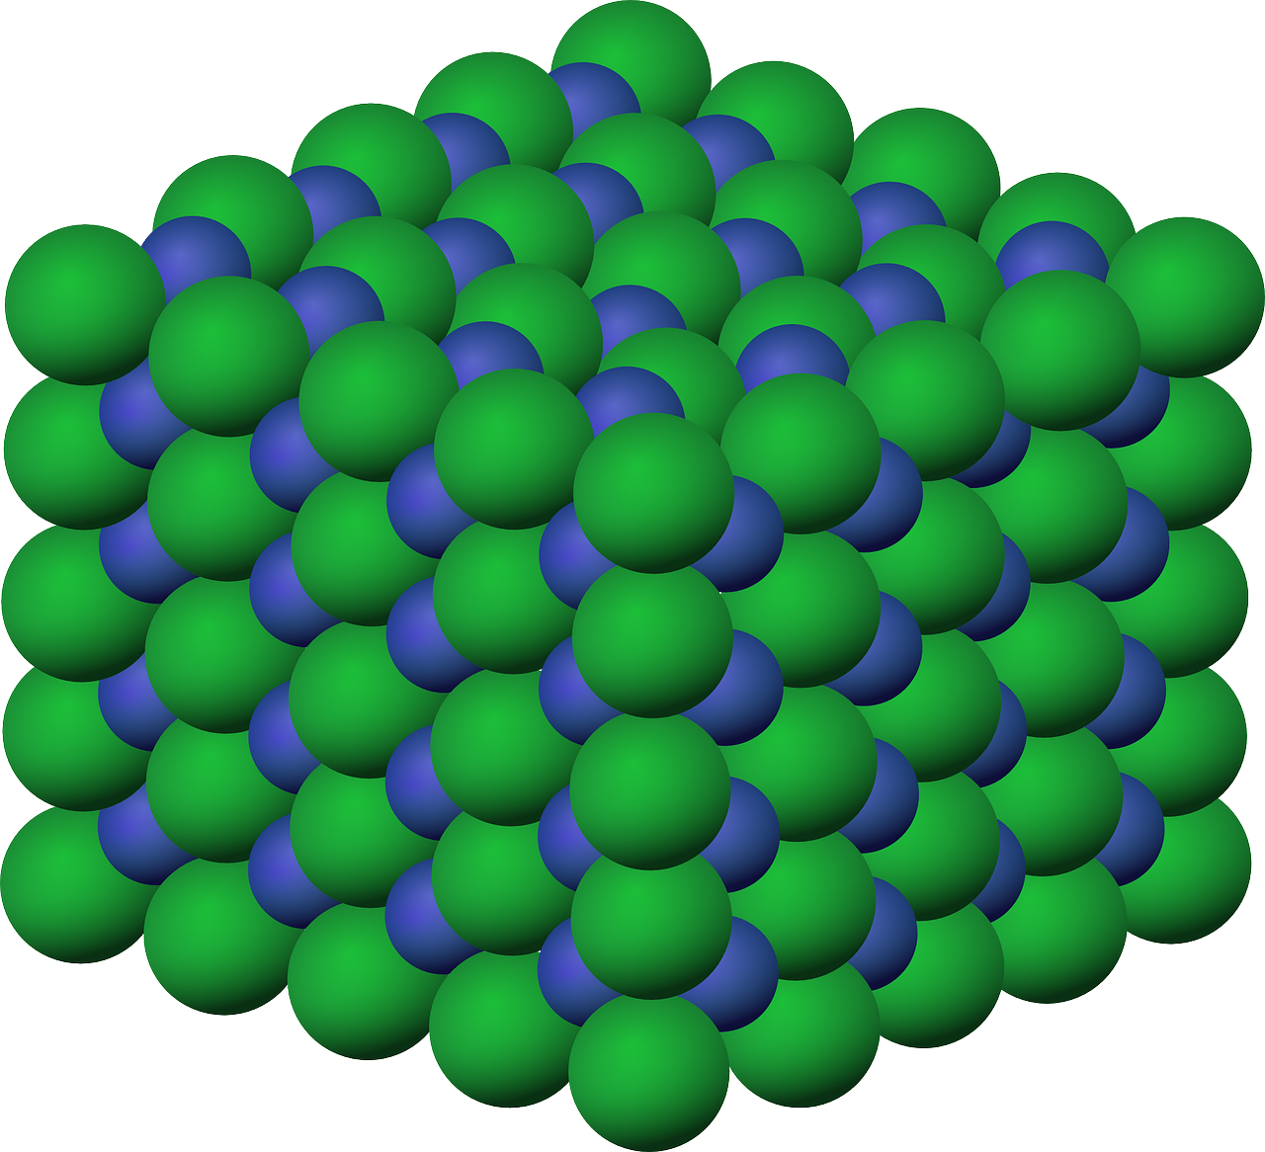
P4.1.5
28/06/2023
Taking it Further:
Pressure
P4.1.1 Prior Knowledge Review
P4.1.2 Density
P4.1.3 Measuring Density
P4.1.4 Gas Pressure
P4.1.5 Taking it Further: Pressure
P4.1.6 Taking it Further: Pressure in Fluids
Notes:
Big Idea: Energy is Conserved.
This lesson is separate science content. It builds on students understanding of pressure from the previous lesson and from KS3.
Suggested Hook:
This tends to be a really engaging topic for students as hydraulics can be a real feat of engineering. An easy way to start is with showing students a car jack and asking them how it is possible for a person to use a simple crank to lift a huge heavy car off the ground.

Slide 6

Following this lesson, students will be able to:
Recall and apply the equation pressure = force/area
Describe the property of liquids that makes them useful in hydraulic systems
Use the equation to solve hydraulic calculations
Key Words:
liquid
pressure
force
area
incompressible
hydraulics
Notes:
Guidance:
See unit overview document and planning guidance to see how these objectives are typically assessed at GCSE, including examples of what students should be able to do following this lesson.
Planning for different needs:
The learning objectives given on this slide are suggested based on the most common requirements for exams, however they can be adapted based on the needs of different classes.
For best practice, the unit preparation booklet should be used to determine the appropriate focus of lessons within the unit.
While it is not possible to explicitly split content into levelled grades, we recommend that lesson objectives can be classified as critical, core or stretch.
Critical: the content or skill is essential for all students to be able to progress.
Core: the content or skill is important for students to progress, but other opportunities may be available to revisit it.
Stretch: the content or skill may not be essential for all students but is important for students aiming for the highest grades.
Key skill: this is a crucial skill being developed in this unit as part of the skill mapping
P4.1.5 Lesson Objectives:
Core: Recall and apply the equation pressure = force/area
Core: Describe the property of liquids that makes them useful in hydraulic systems
Core: Use the equation to solve hydraulic calculations

Slide 7
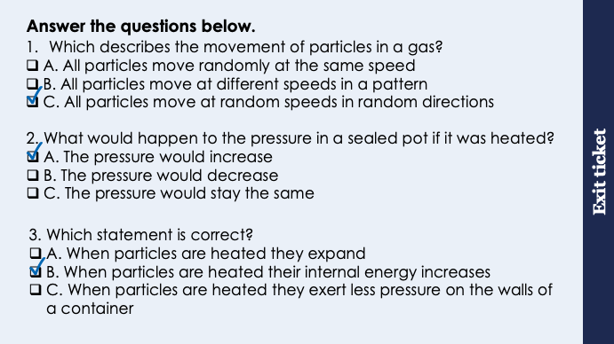
This is the fix-it portion of the lesson
The fix-it is an opportunity to respond to gaps in knowledge, especially those identified by the previous lesson’s exit ticket.
The teacher should customise this slide as needed, to facilitate
reteach, explanation, demonstration or modelling of ideas and concepts that students have not yet grasped or have misunderstood.
practise answering specific questions or of key skills.
redrafting or improving previous work.
Notes:
Purpose: to spend time on any gaps identified in previous learning from exit ticket feedback.
Fix-it guidance from previous exit ticket:
Q1. Answer: C
If students answer A, they have understood the random nature of movement of particles of a gas, but not understood that the particles all have different speeds, which is a key idea and why average speed of particles is referred to. If students answer B, they recognise the different speeds but not the random nature of movements. To fix-it, review the animation or the PhET simulation to look at the movement of particles in a gas.
Q2. Answer: A
If students answer B or C, they have not understood the relationship between temperature and pressure. To fix-it, use the PhET simulation to show what happens to particles when they are heated and how this causes an increase in pressure.
Q3. Answer: B
If students answer A, they have the misconception that heating causes particles themselves to expland. If students answer C, they have confused the relationship between temperature and pressure. To fix-it, review the relationship between temperature and pressure, walking through the stages of heating a substance in terms of: particles gain kinetic energy (which increases internal energy), so average speed of particles increases, so they collide more frequently and with more force with the surface of the container.

Slide 8
General Definition
Scientific Definition
Adjective: (of a substance) able to flow easily
Adjective: not settled or stable; likely or able to change
A substance that has no fixed shape and yields easily to external pressure; a gas or (especially) a liquid
Fluid
‘Anger is the fluid love bleeds when cut.’
C. S. Lewis
Synonyms
Antonyms
General Example
Adaptable
Flexible
Fluent
Firm
Static
Rigid
The ballet dancer’s movements were fluid and beautiful to watch
Scientific Example
In steady fluid flow, the fluid’s density remains constant at every point.
Notes:
Purpose of this slide:
The purpose of the Frayer organiser is to address key scientific vocabulary that students may be familiar with from a non-scientific context. Addressing this at the beginning of the lesson limits the potential cognitive conflict that might arise if students are using their current non-scientific interpretation of a term to understand the science being learned. This approach limits the potential for misconceptions and confusion arising from differing scientific and non-scientific uses of the same word.
The use of this slide is intended to clearly show students
how a word can have both scientific and non-scientific meanings simultaneously
the correct usage of a word in both a scientific and non-scientific context
Teacher guidance:
This slide should be used briefly. Do not dwell on each portion of the slide as this can eat into the lesson quite quickly.
This might be an apt opportunity to ask students to write the scientific definition of the key term into their books. Alternatively, you may want to wait to do this until the term is addressed in more depth later in the lesson.
Suggested narration:
Here we have the word ‘X’. You many already be familiar with this word [display general examples and general definition] in this context. Well, in science, we use this term slightly differently. [display scientific example]. [Display scientific definition]. In science when we use this word what we actually mean is this. You can see that words which mean the same include X,Y and Z. Words that mean the opposite include A, B an C. From this point in the lesson when we refer to this word we’ll be using it in the scientific sense.

Slide 9


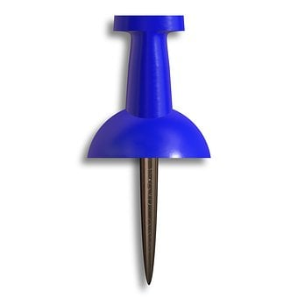
Pressure
Which end would hurt more if you applied the same force to each side? Why?
20 N
20 N
Notes:
This slide and the next slide can be used as a review from P2.1.
Guidance:
You can use this as a think, pair, share activity to gauge what pupils already know about pressure. Many of them will be able to recognise that the same force applied to the sharp/pointy end but will struggle to explain why this is. Without going into too much detail at this point, you may want to get pupils thinking about the contact area.
The thumb on the pointy side will exert more pressure, which would cause more pain.
Is lots of pressure always a bad thing? When might greater pressure be useful?
Pressure = force/area so if the force is the same but the area is smaller, the pressure will be much bigger. This is the key knowledge point from this lesson.
Image source: pixabay
Suggested guidance:
Talk tasks can be used in a variety of ways to suit the particular needs of the students you are teaching. Through exchanging views with others, students develop their understanding of the science beyond what could be achieved individually.
Science classrooms that successfully integrate talk have the following features:
Science talk is a regular feature of lessons and is woven into classroom activities.
Students are paired or grouped strategically by the teacher to ensure productive interaction. This might take into consideration the students’ proficiency of the English language, how encouraging they might be to peers and their attainment in the topic. It’s a good idea to consider these pairings in the class seating plan.
Students are encouraged and supported to talk, but are not forced to talk.
The teacher should take on the role of a facilitator, engaging with conversations where necessary and encouraging or steering the conversation where needed.
Students are encouraged to use the language they have to express their ideas (e.g., everyday language, imperfect English, native language), but also to incorporate science specific terminology where this is more accurate or has been taught.
6. Scientifically inaccurate ideas are not dismissed by the partner or teacher; open discussion and further investigation are relied on to help students construct ideas that support them to progress in their scientific understanding.
7. Guidelines for behaviour during talk tasks are explicit and frequently reviewed. Rules for students might be:
Listen carefully to your partner
Take turns talking.
Speak one at a time, without interrupting.
Politely agree or disagree and explain why.
Politely point out if your partner has used a scientific word incorrectly, if they have explained the science incorrectly, or if there is a more accurate way to describe something.
If confused, ask questions.
Stay focused on the discussion topic.
Respond to one another.

Slide 10
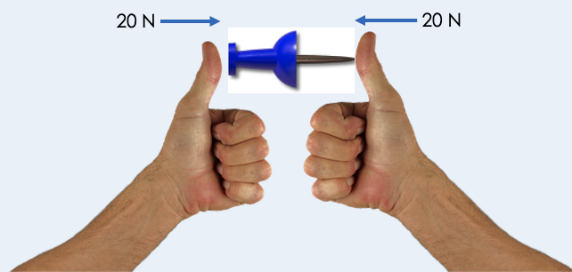
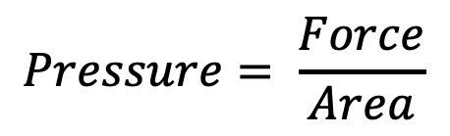
Pressure
Pressure is the force exerted per unit area.
Pressure is a measure of how much force is acting on an area.
Pressure depends on both force and area.
Force is measured in Newtons (N)
Area is measured in m²
Pressure is measured in N/m²
$$Pressure= \frac{Force}{Area}$$
This means that a smaller area will create a greater pressure with the same force acting on it.
Notes:
Exposition type: Explanation
Suggested Exposition:
Pressure is the force exerted per unit area. Remember that per means ‘for every’ so it is the force exerted for every unit of area. It takes into account both the size of the force that is being exerted and the size of the area that the force is acting on.
What is the SI unit of force?
Newtons (N)
What is the SI unit of area?
Metres squared (m²)
As pressure is the force exerted per unit area, we calculate pressure using the force divided by the area. This gives us the SI unit for pressure as Newtons per metre squared (N/m²), although you may also see the units Pascals (Pa) for pressure. 1 Pascal is equal to 1 Newton of force being exerted on 1 metre squared. This is also a very small unit when talking about large forces, so often kilopascals (kPa) are used.
We can use this equation to predict the effects of changing the size of the force or the area on the pressure that is exerted. If there are two areas of the same size and a larger force is applied to one of the areas, more pressure will be exerted on this area. If there are two forces of the same size being exerted and one is exerted on a larger area, less pressure will be exerted. This is because there is a greater area for the force to act over, so less pressure is exerted per unit area.
Let’s look back at our scenario with the pin. Both thumbs are exerting the same force but the thumb exerting the force on the sharp end will exert more pressure because it is acting over a smaller area.

Slide 11
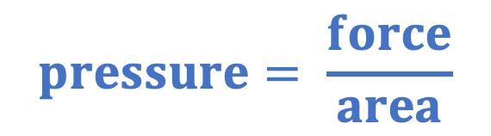
Pressure in Fluids
This is an equation you will need to remember.
Fluids are substances with no fixed shape.
Liquids and gases are fluids.
Fluid particles exert a force on any surface they collide with.
The force acts at right angles to the surface.
They are exerting a force on an area, so they are exerting pressure.
We can use the equation:
$$pressure= \frac{force}{area}$$
Notes:
Suggested exposition:
Pressure is the force exerted per unit area and it can determine the effect of a force on a surface.
Fluids are substances with no fixed shape, so liquids and gases are fluids.
Fluid particles exert a force on any surface they collide with, and this force always acts at right angles (90º) to the surface.
We can use the same equation that we use to calculate pressure exerted by solids to calculate the pressure exerted by fluids on a surface.
pressure=force normal to a surface area of that surface
p=FA
pressure (p) is measured in pascals (Pa)
force (F) is measured in newtons (N)
area (A) is measured in metres squared (m²)
Sometimes we will have values in kN, kPa or cm2 so we might have to convert before calculating.

Slide 12

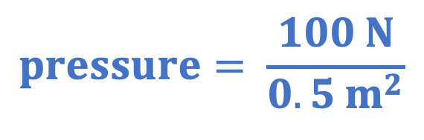
Worked Example
This is an equation you will need to remember.
A fluid exerts a force of 100 N over an area of 0.5 m².
Calculate the pressure on the surface.
$$pressure= \frac{force}{area}$$
$$pressure= \frac{100 N}{0.5 m^{2}}$$
$$pressure=200$$
Pa or N/m²

Slide 13
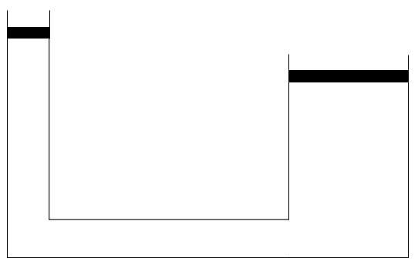
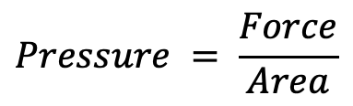
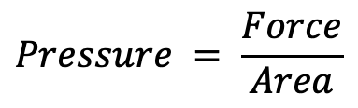
Hydraulic Systems
Particles of a fluid exert a force on any surface they collide with.
A liquid is a fluid that cannot be compressed, so liquids can be used in hydraulic systems.
Force applied
Pressure stays the same, but the area it is acting on is larger, so the force increases
$$Pressure = \frac{Force}{Area}$$
$$Pressure = \frac{Force}{Area}$$
Liquid exerts a force on the other surface
Pressure is transmitted through liquid
Hydraulic liquid
Notes:
Suggested exposition:
Particles of a fluid exert a force on any surface they collide with. Scientists use this knowledge in hydraulic systems. Hydraulics means anything to do with liquid under pressure, so hydraulic systems use liquid under pressure.
Liquids have to be used rather than gases because of one key difference in their properties.
Can gases be compressed?
Yes.
Can liquids be compressed?
No.
Why?
The particles are already close together, there are not spaces between them that can be squashed.
This 2D particle diagram shows that particles of a liquid are close together but randomly arranged and in 3D, they are close together, so they cannot be compressed.
It is this incompressibility that makes them useful in hydraulic systems, so because they cannot be compressed, if a force is applied to the liquid, it is transmitted through the liquid. If a force was applied to a gas, it would be used just to compress it, but that is not possible in liquids.
Hydraulic systems can use the relationship between pressure, force and area to make the most of this property.
An example of this is a car jack, used to lift a car up so that a tyre can be changed, or the underside of the car can be looked at. So it appears that you ‘pump’ the car jack up and this lifts the car. But how can applying a relatively small force to a pump manage to lift a whole car?
Let’s look at how this works.
This diagram is a basic hydraulic system. It has two ends, with a hydraulic fluid (which is a liquid) inside.
The side with the smaller surface area (usually) is called the master, and the side with the larger surface is called the slave. (These are the terms used in engineering).
When a force is applied to the master side, force is acting over an area, which produces pressure. Remember pressure = force/area.
The pressure throughout the liquid remains constant, so the liquid then exerts the same pressure on the slave side. The surface area at the other side is larger, and again pressure = force/area, so if the area is increased, the force has to increase if the pressure has stayed the same.
It is for this reason that hydraulic systems can be described as force multipliers.

Slide 14




Which statements do you agree with?
The larger the area the force acts on, the greater the pressure
The larger the force applied, the greater the pressure
Pressure is the force exerted per unit area
Fluids are liquids
Notes:
Suggested points:
Blue: correct.
Yellow: incorrect. Area and pressure are inversely proportional
Green: correct.
Pink: incorrect. This is a common misconception that only liquids are fluids, because of phrases like ‘make sure you’re drinking enough fluids’.
Suggested guidance:
Talk tasks can be used in a variety of ways to suit the particular needs of the students you are teaching. Through exchanging views with others, students develop their understanding of the science beyond what could be achieved individually.
Science classrooms that successfully integrate talk have the following features:
Science talk is a regular feature of lessons and is woven into classroom activities.
Students are paired or grouped strategically by the teacher to ensure productive interaction. This might take into consideration the students’ proficiency of the English language, how encouraging they might be to peers and their attainment in the topic. It’s a good idea to consider these pairings in the class seating plan.
Students are encouraged and supported to talk, but are not forced to talk.
The teacher should take on the role of a facilitator, engaging with conversations where necessary and encouraging or steering the conversation where needed.
Students are encouraged to use the language they have to express their ideas (e.g., everyday language, imperfect English, native language), but also to incorporate science specific terminology where this is more accurate or has been taught.
6. Scientifically inaccurate ideas are not dismissed by the partner or teacher; open discussion and further investigation are relied on to help students construct ideas that support them to progress in their scientific understanding.
7. Guidelines for behaviour during talk tasks are explicit and frequently reviewed. Rules for students might be:
Listen carefully to your partner
Take turns talking.
Speak one at a time, without interrupting.
Politely agree or disagree and explain why.
Politely point out if your partner has used a scientific word incorrectly, if they have explained the science incorrectly, or if there is a more accurate way to describe something.
If confused, ask questions.
Stay focused on the discussion topic.
Respond to one another.

Slide 15
Can you explain which design is better for a water storage tank?
Both of these tanks contain the same volume of water.
This means there is the same weight acting downwards on the bottom of each container.
Which is more likely to withstand the weight of the water?
Why?
Notes:
Suggested points:
The tank with the larger surface area (the shorter one) would have a larger area on which the force is acting.
This means the water would exert less pressure on this one, which would put less strain on the material.
Suggested guidance:
Talk tasks can be used in a variety of ways to suit the particular needs of the students you are teaching. Through exchanging views with others, students develop their understanding of the science beyond what could be achieved individually.
Science classrooms that successfully integrate talk have the following features:
Science talk is a regular feature of lessons and is woven into classroom activities.
Students are paired or grouped strategically by the teacher to ensure productive interaction. This might take into consideration the students’ proficiency of the English language, how encouraging they might be to peers and their attainment in the topic. It’s a good idea to consider these pairings in the class seating plan.
Students are encouraged and supported to talk, but are not forced to talk.
The teacher should take on the role of a facilitator, engaging with conversations where necessary and encouraging or steering the conversation where needed.
Students are encouraged to use the language they have to express their ideas (e.g., everyday language, imperfect English, native language), but also to incorporate science specific terminology where this is more accurate or has been taught.
6. Scientifically inaccurate ideas are not dismissed by the partner or teacher; open discussion and further investigation are relied on to help students construct ideas that support them to progress in their scientific understanding.
7. Guidelines for behaviour during talk tasks are explicit and frequently reviewed. Rules for students might be:
Listen carefully to your partner
Take turns talking.
Speak one at a time, without interrupting.
Politely agree or disagree and explain why.
Politely point out if your partner has used a scientific word incorrectly, if they have explained the science incorrectly, or if there is a more accurate way to describe something.
If confused, ask questions.
Stay focused on the discussion topic.
Respond to one another.

Slide 16
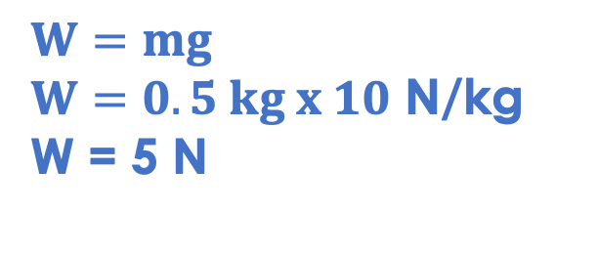
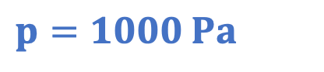
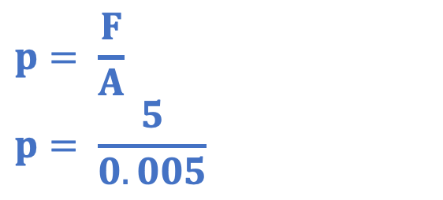
Pressure, force and area
These water bottles all have different shapes but contain the same volume of water.
The bottom shape of each water bottle is shown and their cross-sectional areas.
0.005 m²
Which water bottle will experience the greatest pressure from the water in it?
0.004 m²
The bottle with the smallest cross-sectional area
The bottles each contain 500 ml of water, which has a mass of 500 g. Calculate the pressure exerted on round bottle.
$$p= \frac{F}{A}$$
$$p= \frac{5}{0.005}$$
0.007 m²
$$W=mg$$
$W=0.5 kg x 10$ N/kg
W = 5 N
$$p=1000 Pa$$
Notes:
Suggested guidance:
Talk tasks can be used in a variety of ways to suit the particular needs of the students you are teaching. Through exchanging views with others, students develop their understanding of the science beyond what could be achieved individually.
Science classrooms that successfully integrate talk have the following features:
Science talk is a regular feature of lessons and is woven into classroom activities.
Students are paired or grouped strategically by the teacher to ensure productive interaction. This might take into consideration the students’ proficiency of the English language, how encouraging they might be to peers and their attainment in the topic. It’s a good idea to consider these pairings in the class seating plan.
Students are encouraged and supported to talk, but are not forced to talk.
The teacher should take on the role of a facilitator, engaging with conversations where necessary and encouraging or steering the conversation where needed.
Students are encouraged to use the language they have to express their ideas (e.g., everyday language, imperfect English, native language), but also to incorporate science specific terminology where this is more accurate or has been taught.
6. Scientifically inaccurate ideas are not dismissed by the partner or teacher; open discussion and further investigation are relied on to help students construct ideas that support them to progress in their scientific understanding.
7. Guidelines for behaviour during talk tasks are explicit and frequently reviewed. Rules for students might be:
Listen carefully to your partner
Take turns talking.
Speak one at a time, without interrupting.
Politely agree or disagree and explain why.
Politely point out if your partner has used a scientific word incorrectly, if they have explained the science incorrectly, or if there is a more accurate way to describe something.
If confused, ask questions.
Stay focused on the discussion topic.
Respond to one another.

Slide 17
Drill
State the equation that links pressure, force and area.
State the units for force.
State the units for area.
State the units for pressure.
Describe the effect of increasing the force on the pressure.
Describe the effect of increasing the area on the pressure.
State the property of liquids that makes them useful in hydraulic systems.
Explain why this property makes them useful in hydraulic systems.
Notes:
Purpose: This is a knowledge drill. The purpose of this is to check that the critical knowledge is secure before pupils move onto independent practice.
Suggested guidance: There are a range of ways this could be done depending on time and ability range of the class:
Mini whiteboards
As full sentences in exercise books
As short answers in exercise books
In the pupil workbook
As pair talk
As cold call

Slide 18
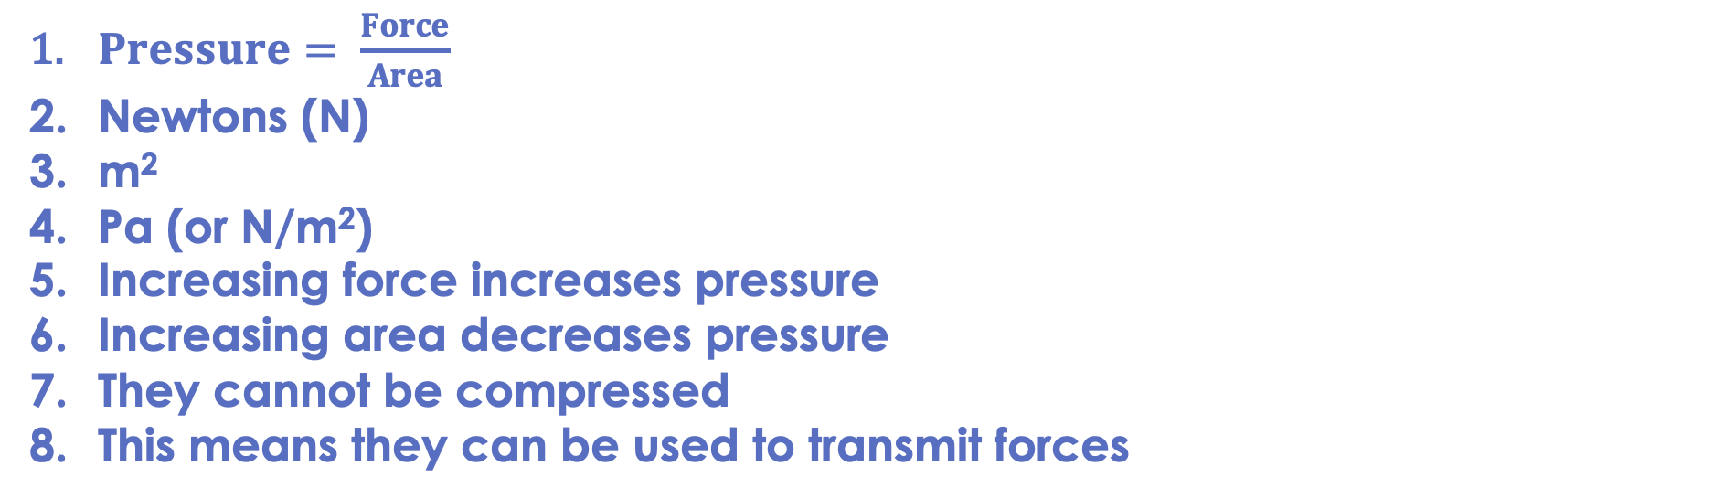
Drill answers
$Pressure= \frac{Force}{Area}$
Newtons (N)
m²
Pa (or N/m²)
Increasing force increases pressure
Increasing area decreases pressure
They cannot be compressed
This means they can be used to transmit forces
Notes:
Purpose: This is a knowledge drill. The purpose of this is to check that the critical knowledge is secure before pupils move onto independent practice.
Suggested guidance: There are a range of ways this could be done depending on time and ability range of the class:
Mini whiteboards
As full sentences in exercise books
As short answers in exercise books
In the pupil workbook
As pair talk
As cold call

Slide 19
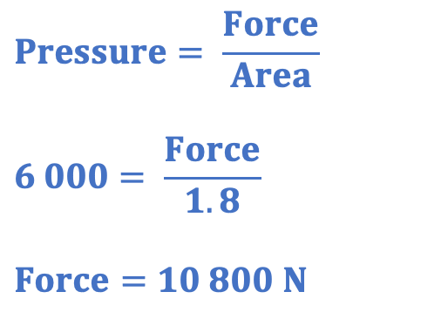
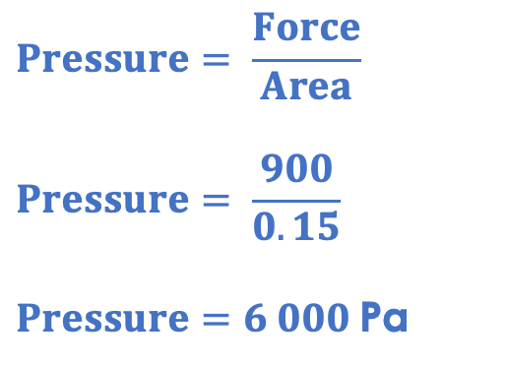
I: Pressure, force and area
$$Pressure= \frac{Force}{Area}$$
$$Pressure= \frac{900}{0.15}$$
$Pressure=6 000$Pa
This diagram shows a hydraulic system used to lift a car.
The system contains a hydraulic liquid.
A force of 900 N is applied to the smaller area.
Calculate the force transmitted to the larger area.
0.15 m²
$$Pressure= \frac{Force}{Area}$$
$$6 000= \frac{Force}{1.8}$$
$$Force=10 800 N$$
1.4 m²
Notes:
Purpose: The I-We-You section aims to support pupils to build skills that they most commonly need when answering questions associated with this knowledge in the assessment. This section is also used to interleave other content we expect pupils to know at this stage of their education in order that they build a big picture of the science they are learning.
For the ‘I’ activity, the teacher should model how to answer the question. They can do this by narrating their thinking process aloud, and making links to learning earlier in the lesson explicit.
For the ‘we’ activity, the teacher and students work though a similar example together, in order to prepare students to be able to answer a similar question independently.
Opportunities for the ‘you’ activity – independent practise – occur in the activity portion of the lesson once the student is secure enough to process independently.

Slide 20
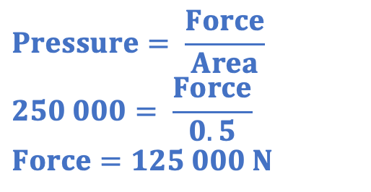
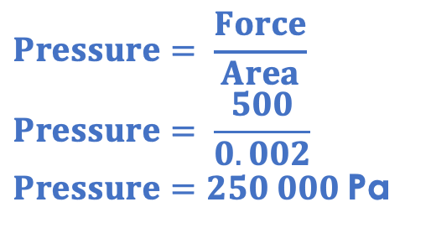
We: Pressure, force and area
$$Pressure= \frac{Force}{Area}$$
$$Pressure= \frac{500}{0.002}$$
$Pressure=250 000$Pa
This diagram shows a hydraulic system used to lift a stage.
The system contains a hydraulic liquid.
0.02 m²
0.5 m²
$$Pressure= \frac{Force}{Area}$$
$$250 000= \frac{Force}{0.5}$$
$$Force=125 000 N$$
What property allows this to work in a hydraulic system?
The liquid cannot be compressed
How does this hydraulic system work as a force multiplier?
A force is applied to the smaller area, creating pressure in the liquid. This pressure is the same throughout the liquid so exerts the same pressure on the larger area. As p=F/A, if the area is larger, the force is larger.
If a force of 500 N is applied to the smaller area, calculate the force transmitted to the larger area.
Notes:
Purpose: The I-We-You section aims to support pupils to build skills that they most commonly need when answering questions associated with this knowledge in the assessment. This section is also used to interleave other content we expect pupils to know at this stage of their education in order that they build a big picture of the science they are learning.
For the ‘I’ activity, the teacher should model how to answer the question. They can do this by narrating their thinking process aloud, and making links to learning earlier in the lesson explicit.
For the ‘we’ activity, the teacher and students work though a similar example together, in order to prepare students to be able to answer a similar question independently.
Opportunities for the ‘you’ activity – independent practise – occur in the activity portion of the lesson once the student is secure enough to process independently.

Slide 21

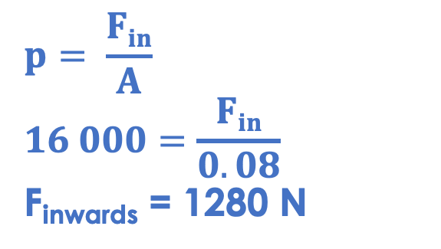
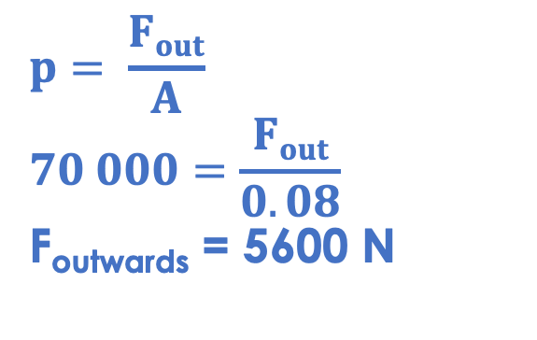
You: Pressure, force and area
Aeroplanes are an example of pressure in real life. Aeroplanes are kept pressurised to keep pressure inside the cabin at 70 kPa.
When an aeroplane is at 14 000 feet, the atmospheric pressure is 16 kPa.
The area of an aeroplane window is approximately 800 cm². Calculate the resultant force acting on the window when the aeroplane is at 14 000 feet.
70 kPa = 70 000 Pa
16 kPa = 16 000 Pa
800 cm² = 0.08 m²
$$p= \frac{Fin}{A}$$
$$16 000=\frac{Fin}{0.08}$$
F_{inwards} = 1280 N
$$p= \frac{Fout}{A}$$
$$70 000=\frac{Fout}{0.08}$$
F_{outwards} = 5600 N
F_{R} = 5600 - 1280
F_{R} = 4320 N outwards
Notes:
Purpose: The I-We-You section aims to support pupils to build skills that they most commonly need when answering questions associated with this knowledge in the assessment. This section is also used to interleave other content we expect pupils to know at this stage of their education in order that they build a big picture of the science they are learning.
For the ‘I’ activity, the teacher should model how to answer the question. They can do this by narrating their thinking process aloud, and making links to learning earlier in the lesson explicit.
For the ‘we’ activity, the teacher and students work though a similar example together, in order to prepare students to be able to answer a similar question independently.
Opportunities for the ‘you’ activity – independent practise – occur in the activity portion of the lesson once the student is secure enough to process independently.
This is an extremely challenging question!
An alternative method is calculating the pressure difference as 54 000 Pa, then using p=F/A.
Stretch question:
Suggest why the window is thicker on the inside than on the outside.
The force from air pressure inside is greater than the force from air pressure outside, so this shape helps to keep the window in position.
Additional information:
If an aeroplane is not pressurised, there can be serious consequences. If pressure in the cabin drops, it will be lower than pressure inside a person’s body. According to Boyle’s law pressure and volume are inversely proportional so if the pressure decreases, gases will expand to fill the volume. This means that gases will expand in the body, causing serious harm!

Slide 22
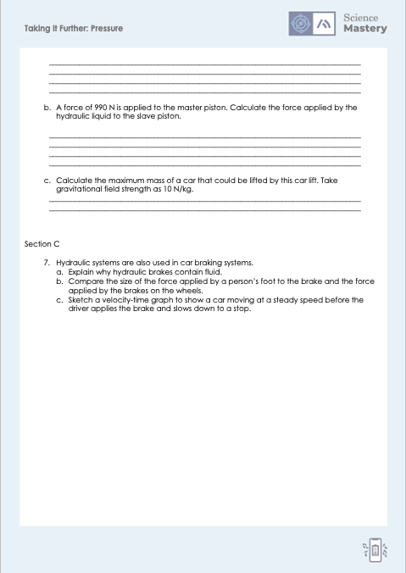
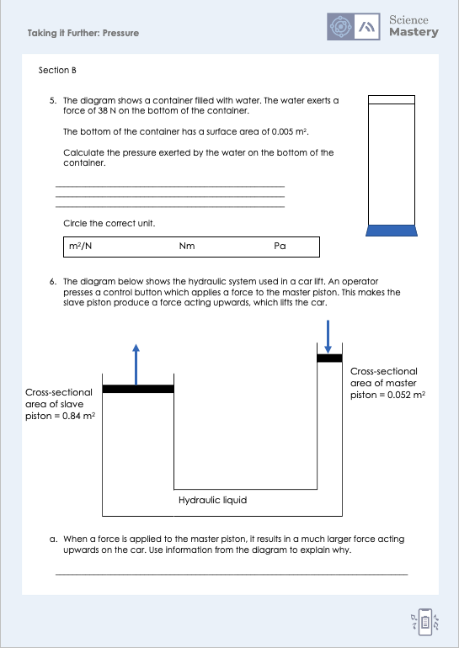
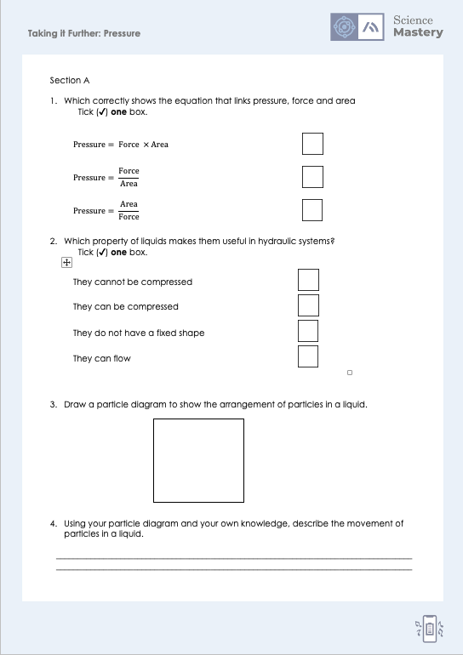
Activity

Slide 23
Answers
1. $Pressure= \frac{Force}{Area}$
2. They cannot be compressed
3.
4. Particles are arranged randomly and not held in a rigid arrangement so can move past each other

Slide 24
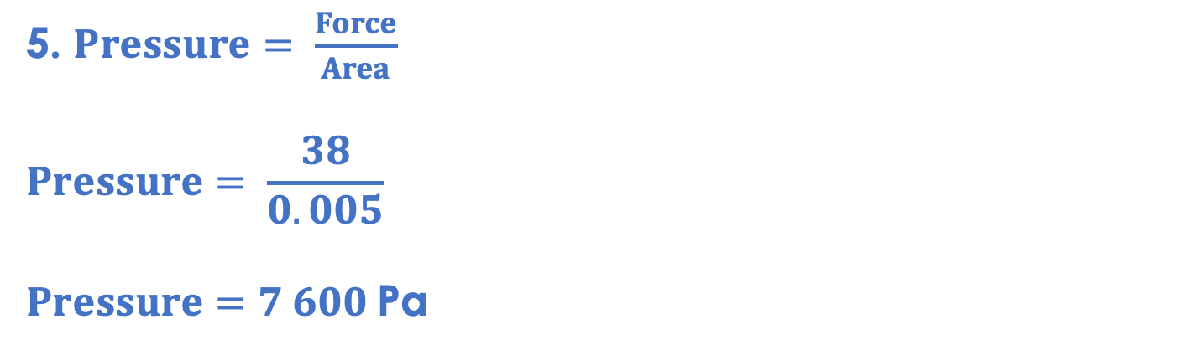
Answers
5. $Pressure= \frac{Force}{Area}$
$$Pressure= \frac{38}{0.005}$$
$Pressure=7 600$Pa
6a.
The downwards force produces pressure in the liquid
This pressure is transmitted through the liquid/is the same throughout the liquid
P=F/A
The area of the slave piston is larger and the pressure is the same
So the force is greater

Slide 25
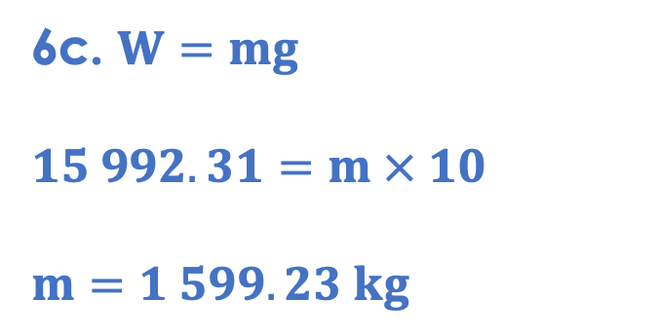
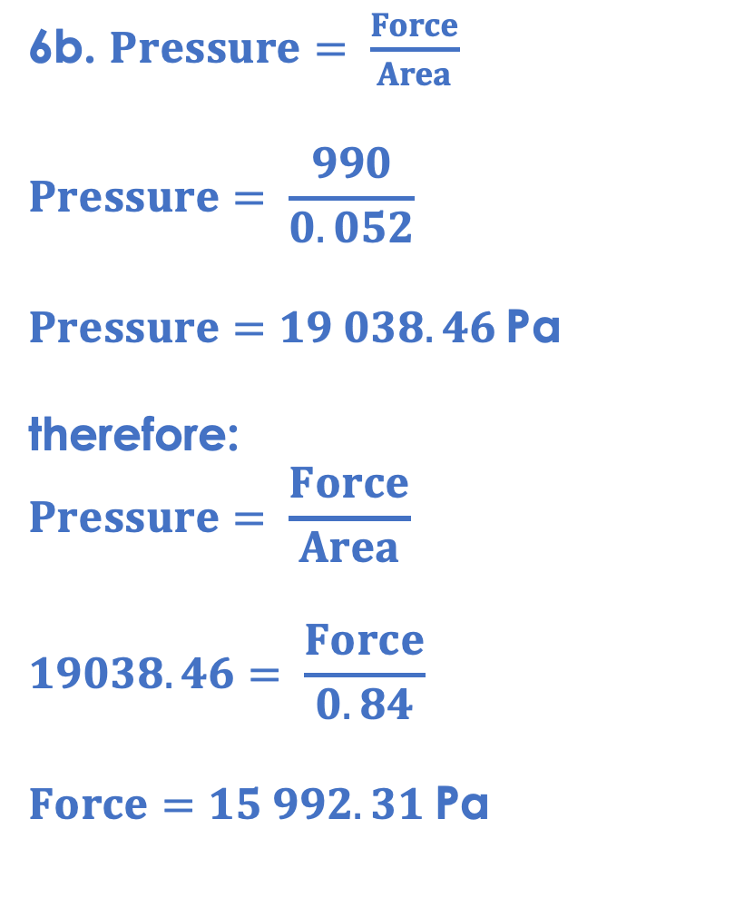
Answers
6b. $Pressure= \frac{Force}{Area}$
$$Pressure= \frac{990}{0.052}$$
$Pressure=19 038.46$Pa
therefore:
$$Pressure= \frac{Force}{Area}$$
$$19038.46= \frac{Force}{0.84}$$
$Force=15 992.31$Pa
6c. $W=mg$
$$15 992.31=m × 10$$
$$m=1 599.23 kg$$

Slide 26
Answers
7a. The hydraulic fluid is a liquid as it is incompressible, so transmits pressure through it.
7b. The force applied by the foot to the brake is much smaller than the force applied by the brakes on the wheels.
7c.
Velocity (m/s)
Time (m/s)

Slide 27
Answer the questions below.
What property of liquids makes them suitable for using in hydraulics?
A. They can be compressed
B. They cannot be compressed
C. They do not have a fixed shape
✓
2. Pressure is exerted by a fluid on a surface. If the area of the surface remains constant but a greater force is applied, what happens to the pressure?
A. The pressure would increase
B. The pressure would decrease
C. The pressure would stay the same
✓
3. What force would be exerted by a liquid with pressure 50 N/cm² on an area of 0.1 cm²?
A. 5 N
B. 0.002 N
C. 500 N
✓
Notes:
Q1. Answer: B
If students answer A, they have confused the idea of compressible and incompressible. To fix-it, review with students what would happen if the liquid could be compressed (the force would be used to compress the liquid not be transmitted through it). If students answer C, they have identified a property of liquids but not the correct property that is related to the function. To fix-it, review what it means for liquids to be incompressible.
Q2. Answer: A
If students answer B or C, they have not understood the relationship between force, area and pressure. To fix-it, give students practice in identifying the effect of changing X on Y.
Q3. Answer: A
If students answer B, they have divided area by pressure. If students answer C, they have divided pressure by area. To fix-it, give students more practice of mixed calculation questions solving for different unknowns.

Slide 28
Lesson P4.1.5
What was good about this lesson? | What can we do to improve this lesson?
Send us your feedback by clicking this link. Thank you!

